Slide 1
Initial Questions or Concerns ?
??
??
As you enter, please add any specific questions or concerns about Competency-Based Education to the chart paper on the wall…
??
??
Optional Technology: Go to … to access a pdf of this PowerPoint and examples
Notes:
Also set up a name tag paper trifold for me & others there early, set out paper/markers for others to do the same as they settle into seats
One paper will already have “Am I going to have to redo all of the competency work I already did?”

Slide 2


Competency-
Based
Education
Kiza Armour
Karmour@pittsfieldnhschools.org
Pittsfield Middle High School
Pittsfield, NH
Notes:
Introductions –
If the group size is small, do a quick round to see who is in the room – name, role, primary reason for attending
Me – teacher… Pittsfield was fortunate enough to receive grant and dove into competency-based education among other redesign efforts… Began ~5 years ago; this is our third year in fully competency-based system. As part of grant, we engage in conversation – visiting other schools, hosting visits by other schools and organizations, participating in conferences. We try to be very transparent about how we’ve approached our redesign work, including missteps, unforeseen consequences, decisions we had to make. Some schools are just starting, some schools are looking to push their practice. We are always looking for different approaches people take, and reactions to our approaches, so that we can continue to push our own practice and grow.
I’ve been asked in these sessions to share some of the different options, but also to specifically explain how Pittsfield is implementing comp-based ed.
Series of three meetings here: Today – Introduction to Competency-Based Education, what it looks like in practice
Second – Dig deeper into writing and evaluating quality of competencies, working with your curriculum
Third – Dig deeper into assessments and ramifications such as honor roll, rolling grades, NHIAA eligibility, exams, report cards & transcripts, and get into more specifics about how information is entered and reported in PowerSchool.
We can adjust plans to best serve your needs.
Look at initial questions / concerns entered on chart papers – identify those we can try to address today vs future sessions vs email / conversation outside the meetings vs those that need other resources / audiences

Slide 3



What is
“Competency-Based” Education?
NH Story of Transformation: http://www.nhstoryoftransformation.com/
  Fred Bramante on reasoning & history for move to CBE
  Minimum Standards for School Approval: ED 306.27 (esp. u)
Credit for competence, not seat time or amount of work
I CAN…
Skills
Knowledge
2008-2009
Notes:
WATCH the Fred Bramante video, reference ebook & min standards as needed in conversation
Bramante was state school board member (chair?) and leading voice for competency-based ed
Fundamentally, competency-based means the school defines what a student must be able to know & do in order to earn a diploma, assesses mastery of those competencies, and serves as one of many different resources to help the student reach mastery, regardless of how long it takes an individual student to do that.
BUT this is New Hampshire…. There are hundreds of different interpretations of exactly what this means even just within this state…
Overall approach you take drives what your “competency statements” look like.
I’m going to go through some different approaches; I’ll pause at a couple points for you note some pros/cons, further questions or concerns occurring, ramifications, etc… Then I’ll overview Pittsfield’s approach. If anyone here is using a different approach they’d like to offer out, that would be great. By that time I expect there will be a BUNCH of questions & concerns bubbling. We’ll take a few minutes for people to add general questions & concerns to the chart papers, refill coffee, etc…
Then I’ll go into more detail about Pittsfield’s approach

Slide 4
Different Interpretations:
Traditional Assignments
Traditional Percentage or Points-based grades with…
a separate Pass/Fail for competencies
high-stakes “competency-based assessments”
assignments grouped and averaged by course competency; any competency average below passing=manual “F”
assessments grouped by competency; mode or most recent vs average; manual “F”
“Teacher Gut” grade + narrative (usually K-2)
Notes:
So if we consider some of the different approaches, from those that didn’t make much systemic change to those that are making some fundamental changes to their practices…
“grades” --> assignments, assessments, etc…
Some schools say every standard in the subject area is a competency, most schools group them in some way
a separate Pass/Fail for competencies – “passed” the course but failed the competencies, or vice versa
high-stakes “competency-based assessments” -- like college courses where most of the grade is based on one or two exams or papers…CBAs are weighted such that you cannot achieve minimum passing percent without “passing” most CBAs. Some schools are more clear than others about whether you have to pass all the CBAs or just average out to a passing mark
assignments grouped and averaged by course competency… Using the “categories” in the gradebook…. If the average for any individual competency group is below passing, then the teacher manually marks the course grade as an F.
assessments grouped by competency… The single most recent score or the average of most recent 3/whatever # or the mode is used to give competency score. Define “MODE” --- the score that occurs most often….All competencies must be passed to earn course credit…. Issues with not having a mode, with kids not bothering to do early assessments because they know they won’t count…
Have to offer… “Teacher Gut” grade – especially at lower elementary levels, “grades” or progress in different categories – just changed categories to be standards… Narrative is more important than the “grade”

Slide 5

? Assessing Competence ?
In a more traditional approach, how does a student demonstrate mastery of a competency without “doing the time” in your class to complete all of your assignments?
Notes:
Minute private reflection or turn & talk
A teacher might look at some student work or talk with a student and “know” in their gut that “this kid’s ‘got it’” – but how does the student / community know what the student needs to demonstrate? What about the cases that aren’t as obvious?
What about the kid who says I spent the summer in a Shakespeare camp – we translated Midsummer Night’s Dream to modern language and then performed it… I should get credit for the English Lit class… But your English Lit class reads Hamlet? Any English teachers in the room? Are you really just interested in whether they can interpret a Shakespearean play? What are the REAL skills and understandings that you want the kids to have? What LEVEL do they need to reach to earn credit?
HOW DO THE KIDS/COMMUNITY KNOW THAT?
So some schools use competency rubrics…

Slide 6
Different Interpretations:
Competency Rubrics
Rubrics for each course competency
  Competencies divided into learning targets…
Competency rubrics used for all assessments
All assessments of a given competency have the SAME value / weight, competency score determined by
  the median or mode
  the average of the most recent xxx
  a weighted average of the most recent xxx competency assessments
  (ie, 1st = 10%, 2nd=30%, 3rd=60%)
All competencies must be “passed” to earn credit
“Grade” may competency avg, or avg +10% formative…
Notes:
If students/community are going to be able to tell whether a given experience / performance / work product done outside of the classroom demonstrates mastery of a competency, then those rubrics MUST be detailed and high-quality --- some of the “some understanding” “good understanding” “superior understanding” descriptors that sometimes pass as rubrics just don’t cut it.
Exam, project, homework, etc… all assessed against SAME rubric…. Some schools create different rubrics for every assessment, and just require that those assessment rubrics clearly connect to the competency rubric…
In class, competency might build over time – while I’m learning, how do I know if I’m “on track”? How many “passing” assessments does it take to demonstrate mastery?
Claremont – just started requiring 10% of course grade is for “formative” – but not broken out by competency… some schools do similar things but include a percentage for a midterm or final exam…
Minute private reflection or turn & talk

Slide 7
Different Interpretations:
Rubrics & Portfolio-based “Gateways”
Expectations for each grade level “division”
Feedback is given as students complete performance tasks
When an assignment meets expectations, student puts it into portfolio
When the student has work samples to demonstrate meeting all division expectations, he / she “gateways” to next division via formal presentation and review by experts
This is extreme version of pushing practice…
Public Schools???
Notes:
Courses “cycle”
I’ve only heard of this extreme at charter schools, specifically Parker… but we’re trying to go that way….
STRONGLY considering having our 21st Century Learning Expectations assessed via student work demonstration on Exhibition Night… (1 pm – 7 pm school day…) but this is really getting into some of the redesign work that is outside the intended scope of these meetings…
Milwaukee? Michigan? Charter school Louise visited a few years ago where students

Slide 8
Different Interpretations:
PMHS, Overview…
Rubrics for each course competency (or indicator)
Competency rubrics used for all assessments
Assessments within a competency can have DIFFERENT values / weights
  formative vs summative
  breadth vs depth
Teachers use “EXEMPT” as appropriate, to discount formatives based on summative or to count only the most recent xxx…
Competency score = weighted avg of competency assessments
“Grade” AFTER meet all course competencies
Notes:
There are other schools like PMHS that mix rubrics and weighted assessments too…
ELEMENTARY is just beginning to move to competencies…
Remember: Details next, don’t get hung up here…

Slide 9
Others?
Other approaches anyone wants to offer?
Please post Questions / Concerns to the chart paper…
More Details in 3 minutes…
Notes:
Graphic – bubbling… questions
Check Time – expect to be ~45 minutes into session
HAND OUT EXAMPLES:
5 21st Century Learning Expectations & 1 example rubric
Course Competencies & Indicators for Physical Science, English 10, and Geometry
Example rubrics for Physical Science indicators (experiment design, dynamics, incremental math problem solving, incremental atomic structure)
Example rubrics for English 10
Example progress report / standards screen for a student
Example scores detail screen for a student

Slide 10
PMHS…
Other Schools…
PMHS
X
Y
Z
Not as consistent as it may seem from outside…
Notes:
EDC report cited as a strength that we all had similar ideas about competencies, assessments, etc…
A lot of us laughed at that, because it doesn’t seem as consistent from inside the building, but our approaches tend to be more similar to one another than to other schools…
It’s not necessarily a bad thing – we’ve tried lots of different things and there are pros/cons to each…
We’re probably not the only school that’s less uniform than we might think or theoretically want…

Slide 11
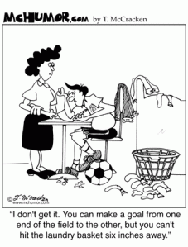
Does Sloppy Sam “Pass”?
Procrastinates, sloppy handwritten assignments, disorganized, doesn’t work well with others, but “science” is OK…
Does he earn credit for physical science?
  Do we report on the school to career skills?
Notes:
SloppySam is a terrible procrastinator, doesn’t “type” assignments, handwriting is sloppy, notebook is a mess, he doesn’t work well with others…
He “gets” the content, he can do the lab experiments, his graphs & lab reports have all the pieces and the content quality is there…
Does he earn credit for physical science?? Do I still want to report out about those School to Career / 21st Century Skills?

Slide 12
Different Types of Competencies
Course Content Competencies
…
Art I
EM
PE
Energy
Mechanics
Physical
Science
Math in Science
Spanish II
21st Century Learning Expectations
Science Process
Later…
Geometry
Advisory
SLO
English 10
Economics
Learning
Studio
Notes:
SloppySam is a terrible procrastinator, doesn’t “type” assignments, handwriting is sloppy, notebook is a mess, he doesn’t work well with others… Does that mean he doesn’t earn credit for physical science?? Do I still want to report out about those School to Career / 21st Century Skills?
WE SAID YES TO BOTH…
We defined & created school-wide rubrics for 21st Century… agreed that they should be SEPARATE from course competencies…. Should MATTER, like our effort & conduct grades used to – they factored into honor roll, privileges, showed on report cards, etc… But it was TOO MUCH ALL AT ONCE… we didn’t have a way to do it, and dropped it temporarily.
Also now using competencies for SLOs and Learning Studios, but those are outside scope of these sessions…

Slide 13
Content Competency Statements
Understanding By Design
“Enduring Understandings”
Students will understand that…
i3?
Students will demonstrate the ability to…
I Can…
I Can…
5-10 competencies per full year course,
~3 indicators per competency
Notes:
Initially, UBD format for competency… like early state model course competencies with Rose Colby
I Can… as “indicators”
Rubrics are for the indicators
Then ideas at state & school level changed… State Science subject-area competencies under Rose Colby have “students will demonstrate the ability to…” format. (Kearsage science teacher contributed to those) Many teachers who came a year later used competencies of second form.
Many teachers started with MORE competencies, then reduced / consolidated once they started trying to actually assess each competency.
We did a terrible job supporting new teachers – OOPS! Last year, they entered whatever… This year, vet through dept.
More details on vetting & crosswalking with nat’l / state standards in next session….

Slide 14
“Indicators”…
Physical Science Competencies have Indicators
Engineering
C1 Science Process
Indicators suggest breadth of skills, without requiring mastery of each
Experiment Design
Use of Equipment
AVERAGE of Indicator marks = Competency mark
Describing Motion
C7 Mechanics
Force Diagrams
Newton’s Laws
Many teachers are moving AWAY from using “indicators.”
Notes:
“Indicators” are sometimes called “Learning Targets” in other districts.
Indicators are specific performances in the form of “I Can….”
Indicators mean defining your curriculum more specifically… but since rubrics are for indicators, what happens when someone takes a different approach to competency (VLACS, transfer student, ELO…) – Do they really have to show my specific indicators???? Sometimes I think YES – they are aligned to state standards and ensure breadth of understanding, not just depth…. But now NGSS is structured differently… especially as state language is shifting toward “graduation competencies” vs course competencies, and as we try to push toward “bigger” assessments, I wonder about the level of specificity…

Slide 15
“Competency”
Statement
“Teacherese”
RUBRIC
4 point scale
2.5 is “passing”
“Competency”
Vetted with grade-level AND department teams
Notes:
MUST HAVE RUBRIC to indicate expected level of mastery – otherwise your statement is acting more like a grouping container, and everyone has to guess what it takes to actually demonstrate competence. EXEMPLARS of past assignments are also used whenever possible.
Rubrics need to address the specific knowledge / skills / vocabulary, etc…
In UbD language, a ‘competency’ IS the standards, enduring understanding, knowledge, skills, vocabulary, AND the main part the assessment
PUBLIC needs to be able to make sense of them

Slide 16
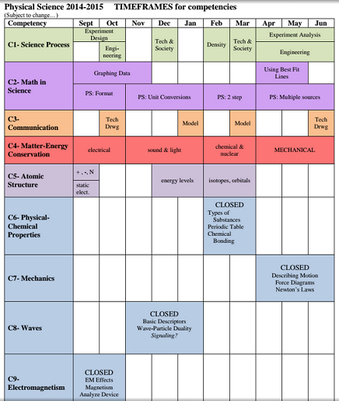
“Open” vs “Closed”
Competencies
Open – assessments throughout the year
  Breadth – apply in multiple contexts
  Incremental – build level of mastery over multiple units of study
Closed – studied during a specific time or unit in the course
Notes:
If we finish class time on a competency and the student hasn’t demonstrated competence, he makes a competency recovery plan – he might do a VLACS comp recovery module, or use Kahn academy / other resources / see me afterschool, then redo an assessment…
Example breadth – science process skills, energy
Example incremental – math problem solving, atomic structure

Slide 17
Same content “competency” in multiple courses?
NO!
Same competency STATEMENT in multiple courses, different RUBRICS
  English – common core with incremental rubrics
  Science – incremental rubrics grade 8 vs 10,
  different context / indicators & rubrics in bio vs psc
well, maybe…
Special education – “same” course, but not exactly…
“Semesterizing” to create more of a 9-10 “Division”…
Notes:
At least in our system…. You only demonstrate a course competency ONCE. Overlapping competencies would be like having two courses that taught the exact same unit (not interdisciplinary courses)…
“Skills” courses for special education students --- for very special cases where the student will truly have a MODIFIED curriculum, NOT just ACCOMODATIONS… These are not pull out classes… students are in regular classroom, but teacher sees a different gradebook, and course is reported as “physical science skills” vs “physical science”… most competencies & rubrics are exactly the same. Usually, we don’t actually take time to write out the modified competency and rubric, but we do a LOT of communicating about the details of the expectations.
In interest of transparency… It is POSSIBLE that the first year we “semesterize,” teachers may not have sufficiently divided the semesters…
Also, sometimes we “ghost” individualized sections – ie, Studio Art 2… teachers don’t always have time to develop “real” competencies…

Slide 18
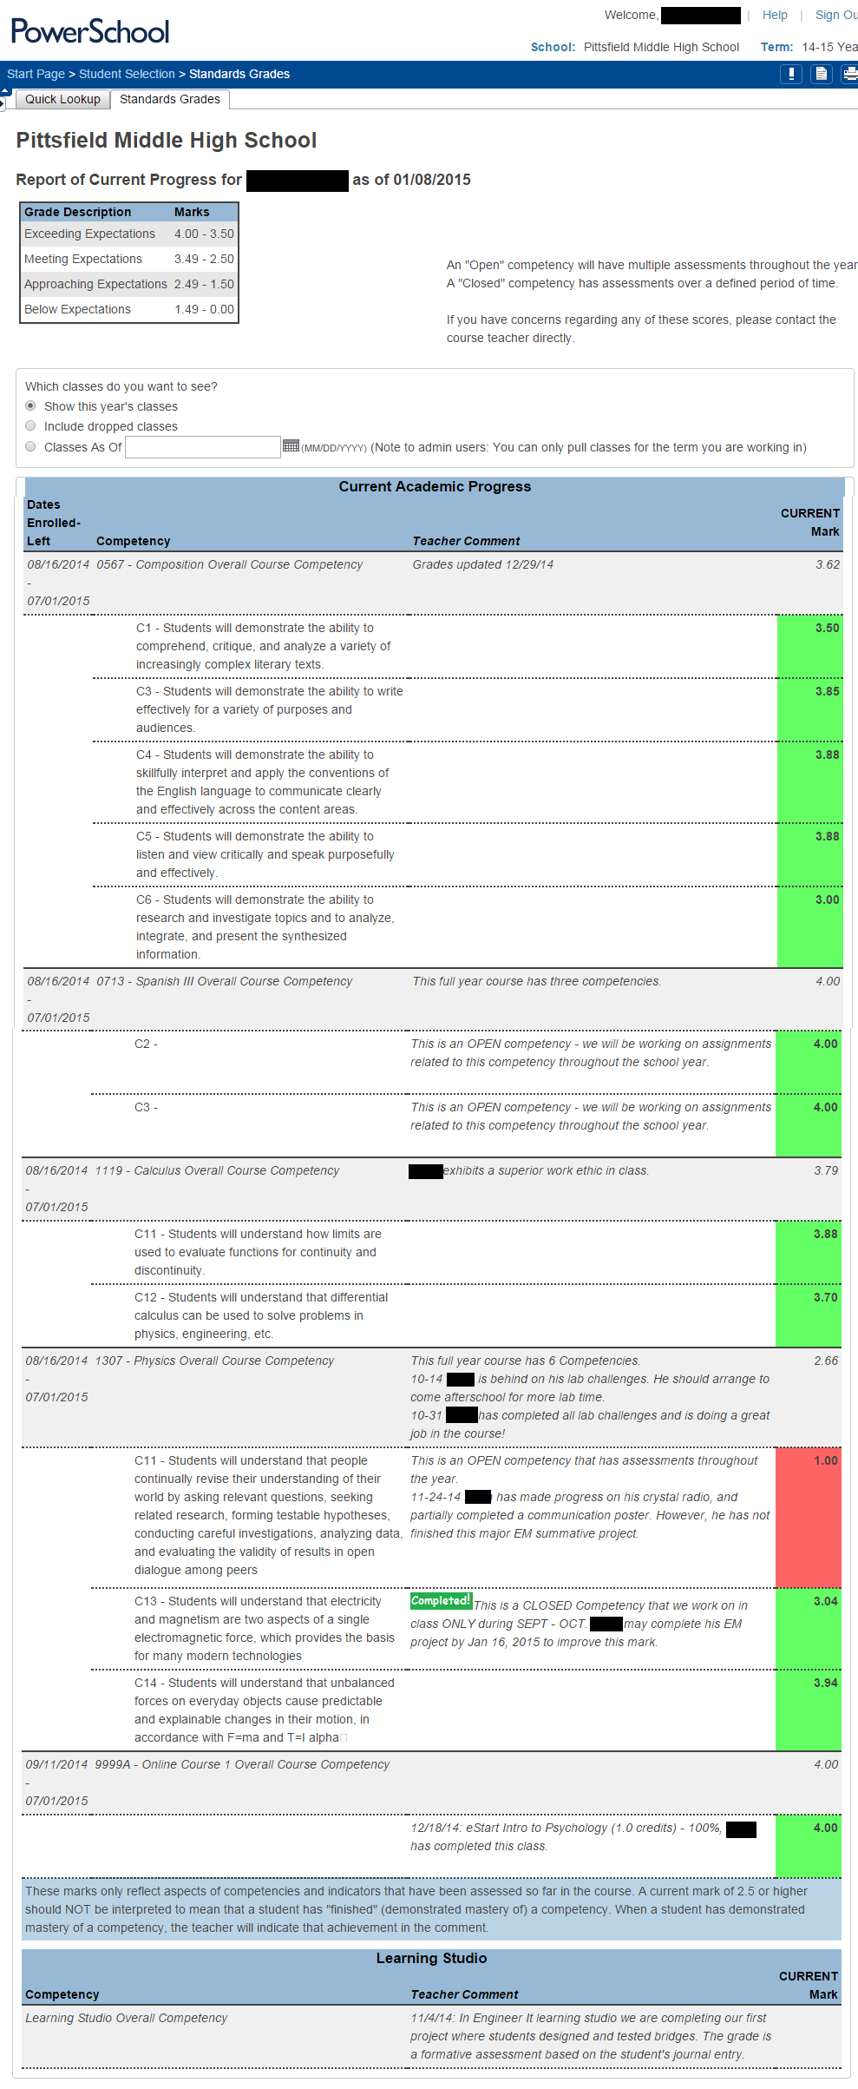
PMHS Quarterly
Progress Reports
EVERY assessment is of competency – there is no separate “grade”
*Rolling Grades!
LIVE on Web!
Overall & Comments
Print the screen and mail it home each quarter…
Transitioning parents away from need for printed copy…
Competencies & Comments
Notes:
EVERY assessment is tied to a competency or indicator rubric. There is NO separate “percentage.” There is no “grade” until the student has completed EVERY competency in the course.
“Rolling Grades” – there is no “quarter 1” grade that gets averaged with a “quarter 2” grade – there is just where you are at any given point in a course…
Notice the fourth class --- one closed competency marked as completed. One RED open competency, one green open competency – this student is focusing attention on his science process skills, because he knows he’s doing fine on his mechanics content…
Assessment of COMPETENCE – he didn’t do well on his first quarter EM experiment lab report. He’s been focusing attention on improving in that area. He’s just done a friction lab report, and that grade has REPLACED his EM lab report score.
Custom “Standards” Tab
From Quick Lookup →
Shows Course Competencies
AND Comments

Slide 19
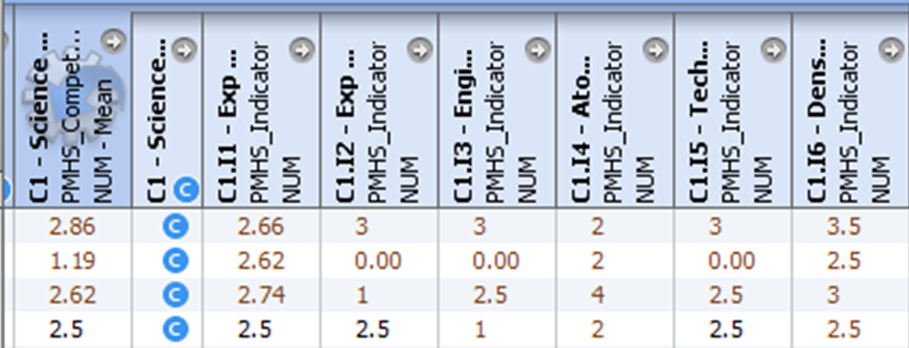
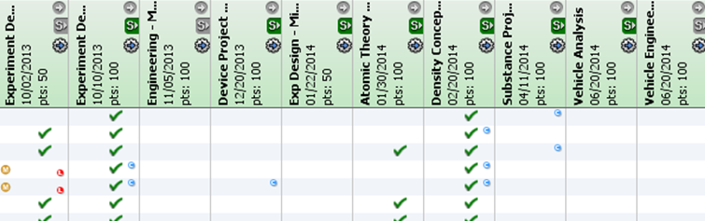
Competency Marks Example: Indicators
Science Process Competency – “Open”
Multiple Indicators – BREADTH --student can be “competent” in science process in many ways:
… Summer Competency Recovery Project – manual override of calculated competency grade…
Indicator rubrics are used for all assessments; some indicators are assessed multiple times…
Notes:
First student – clearly competent
2nd – can design experiments and use equipment, but does not have enough breadth – can’t analyze, engineer, discuss synergy of science & tech or describe how experiments build on one another… overall NOT competent
3rd -- didn’t demonstrate ability to analyze data, but overall, competent
4th – done a different way over the summer, not though my assignments at all…
Don’t NEED Indicators to do this – but it helps to separate out & define the specific skills you’re saying they can or can’t do…

Slide 20
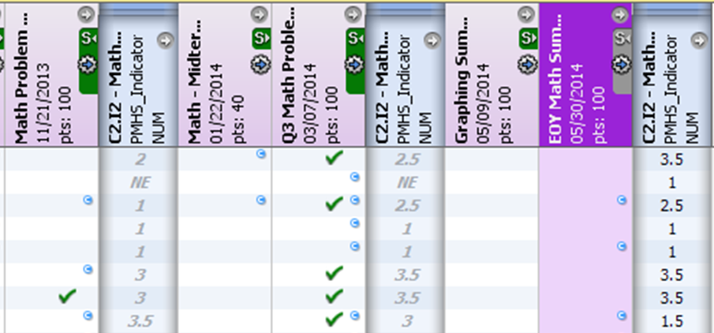
Competency Marks Example: Incremental / Most Recent
Math Problem Solving Indicator – “OPEN”
Expectations on rubrics increase throughout year –
3 incremental rubrics, final rubric “counts” in the end
When next level assessment is taken, teacher “exempts” previous one….
For this indicator, only single most recent assessment “counts” at any time…
(next year, most recent TWO counted)
“Exempt” –
NOT counting toward weighted avg
Notes:
A single click lets the teacher “exempt” all the marks for that assignment when the next class assessment / benchmark point is reached.
Each student working at own pace? Teacher can exempt prior level assessment for individual student as he/she reaches each new benchmark level.
Midterm Exam assessment ALWAYS counts.

Slide 21
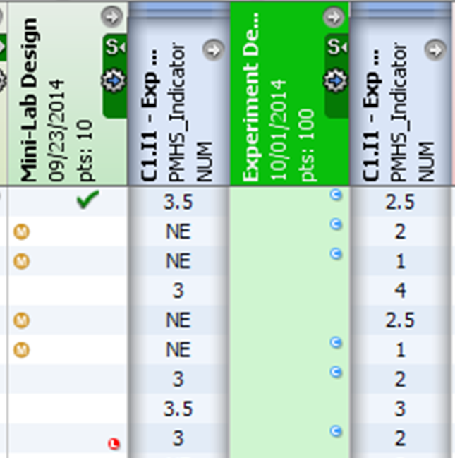
Competency Marks Example: Formative vs Summative
“Weighted Average” still means the system considers how many points the assignment is worth…
•Students tended not to do formative assessments because they weren’t being graded.
“HW” formatives often can not be redone / late
• Some formatives are “ticket” to take summative
• Teacher can easily exempt formatives as appropriate
Notes:
Notice fifth student – NE on formative, but passed summative. For the week between the two assessments, his grade was bad – maybe no open campus privileges… but chances are that we exempted that formative.
Notice sixth student – better on formative than summative – part anxiety, part structure/choice/timeframe… formative SLIGHTLY raises overall indicator mark… NOT EQUAL – not a 2.5 avg

Slide 22
“Formative” vs “Summative”
Formative – “for learning”
  Homework, exit cards, early steps in a project, some “quizzes,” rough drafts
  Often don’t have same breadth or level of rigor
Summative – “of learning”
  “Tests,” final papers, some projects (especially if “teaching” is done first)
  What about “Assessment AS learning?” What do you do with a project that is also the vehicle for instruction?

Slide 23



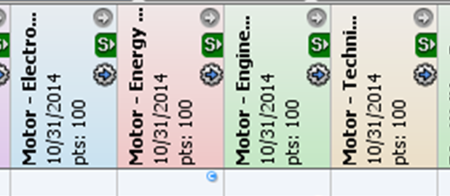
Competency Marks Example: Projects
Motor Project Grade
Motor Project
Written Test
REassess
Energy
Energy
EM
Engineering
Technical Drwg
Vehicle Project
REassess
Energy
Mechanics
The Motor Project is entered as FOUR “assignments”
Engineering
Technical Drwg
TRANSITION – away from a “motor project grade” toward individually assessing competencies that may be demonstrated in that project. Entering as different assignments pushes that paradigm shift.
Notes:
Example: Motor engineering project earns marks in C1 science process (engineering), C9 electromagnetism, C3 communication, & C4 energy.
What if the student does a great job with the communication (technical drawing), electromagnetism & energy content, but does not demonstrate good engineering process skills? Why would the student have to “redo” the motor project? The student can demonstrate competency in engineering during the vehicle project.
Maybe the engineering in the motor project is really a formative, and the vehicle is the summative…. But if they can show the expected level of engineering in the motor project, it can also be a summative… Originally, I wanted two demonstrations of engineering – showing some breadth – but now I realize that many students need the motor project AS learning for engineering, and then the vehicle can be OF learning for engineering.
***TRANSITION – away from a “motor project grade” toward individually assessing competencies that may be demonstrated in that project. Entering as different assignments pushes that paradigm shift. Note - You COULD create one assignment for “motor project” and connect that assignment to four competencies… BAD PRACTICE – difficult for teachers to shift thinking, so they end up giving one “grade” and just “counting” it for each of the four competencies.
Starts to REALLY push practice – example with student ME in psc class – no model on her waves project, but is taking Health this semester, will do a project on a body system… health doesn’t have competency around creation and use of a model in communication, but no reason she couldn’t make one as part of the health project to support her communication – then show me her health project, so I can assess her creation & use of model….

Slide 24
Wrapping Up…
Questions / Concerns for TODAY that we did not address?
What are your next steps?
  Information to gather?
  People to involve in the conversation?
  Decisions to be made? (by whom?)
Notes:
Check chart papers for any details to address quickly or privately, or anything that may need to wait till next session…
Encourage people to take a moment to consider what they need to do next…

Slide 25
As you leave…
Add questions / concerns for the next session….
MARCH 26, same time & place….
Bring your curriculum materials, specifically for a May unit in a current course if possible…

Slide 26
Competency-Based Assessment and Reporting
Pittsfield Middle High School
Pittsfield, NH
School Year 2014-2015

Slide 27
What is
“Competency-Based” Education?
NH Story of Transformation: http://www.nhstoryoftransformation.com/
  Fred Bramante on reasoning & history for move to CBE
  Minimum Standards for School Approval: ED 306.27 (esp. u)
Credit for competence, not seat time or amount of work
I CAN…
Skills
Knowledge
2008-2009
Notes:
WATCH the Fred Bramante video, reference ebook & min standards as needed in conversation
Bramante was state school board member (chair?) and leading voice for competency-based ed
Fundamentally, competency-based means the school defines what a student must be able to know & do in order to earn a diploma, assesses mastery of those competencies, and serves as one of many different resources to help the student reach mastery, regardless of how long it takes an individual student to do that.
BUT this is New Hampshire…. There are hundreds of different interpretations of exactly what this means even just within this state…
Overall approach you take drives what your “competency statements” look like.
I’m going to go through some different approaches; I’ll pause at a couple points for you note some pros/cons, further questions or concerns occurring, ramifications, etc… Then I’ll overview Pittsfield’s approach. If anyone here is using a different approach they’d like to offer out, that would be great. By that time I expect there will be a BUNCH of questions & concerns bubbling. We’ll take a few minutes for people to add general questions & concerns to the chart papers, refill coffee, etc…
Then I’ll go into more detail about Pittsfield’s approach

Slide 28

Competence vs Amount of Work
Can you demonstrate required understanding & skills?
Is it “fair” that I completed more “work” in order to reach the same understanding, but our “grades” are equal?
Notes:
Teachers need to be intentional about required BREADTH vs DEPTH
Unfortunately, gradebook structure means assignments are given to a “class” – not to a student. Therefore all the students in the class have all the same assignments, even though we want to give some students more practice, some different practice, some don’t need practice…

Slide 29
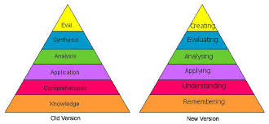
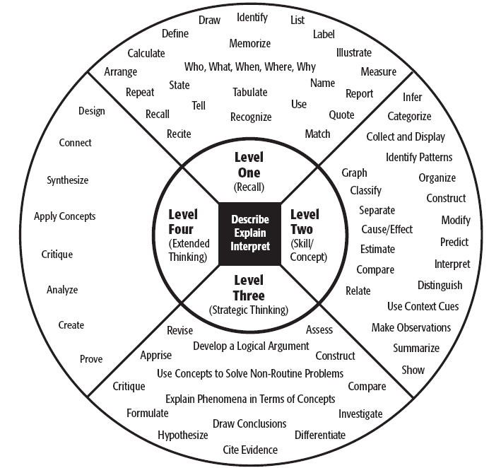
“Knowledge” ???
“Competence”??
PMHS → Aim for “Application” / DOK 3 = ‘3’ on rubric
=minimal “mastery”

Slide 30
Competency-Based
Currently…
Each course has content competencies with 4 point course-specific rubrics
Students earn credit only after demonstrating mastery of every competency in the course
Every assessment connects to a competency rubric
Avg competency marks → Transcript Letter Grade
Intended…
Five School-Wide 21st Century Learning Expectations
Single 6 point rubric for each 21st Cent. LE used by all teachers, courses, grades, providing FORMATIVE assessment
Annual summative assessment of 21st Cent LE for each student happens at Exhibition in June
21st Cent LE are NOT calculated into course marks
??

Slide 31
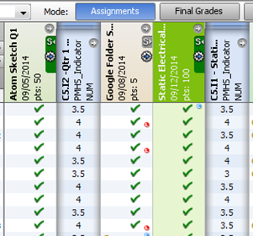
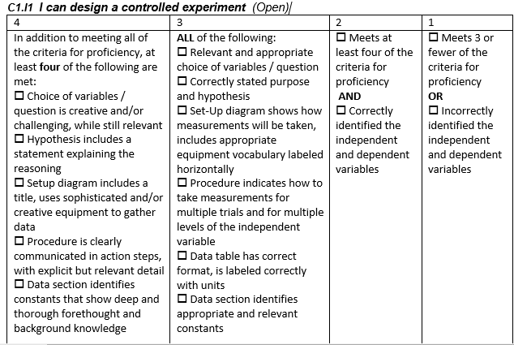
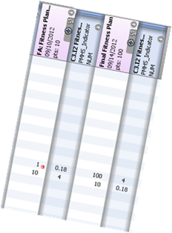
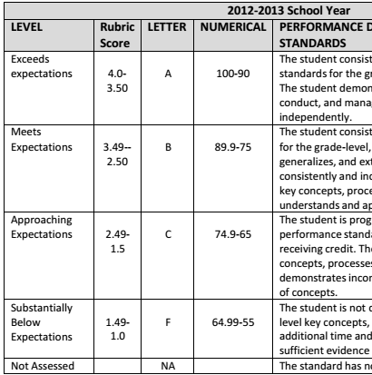
Paradigm Shift…
% → Competency
2014-2015
Marks on competency rubrics, not assignment percentages
How am I doing on EACH competency…
On this assessment, I earned xx on the competency rubric
2013-2014
My overall competency average is xx right now, so I’m “passing” the course…
2012-2013
Rolling Grades
I earned xx%…
What competency grade is that?
2011-2012
More consultants and team vetting… Spring Semester “pilot” by some teachers… how does this work in the classroom?
2010-2011
Consultants, visits to other schools, teacher team work to develop and vet competencies
Notes:
For us, the big shift was from the idea of overall percentage grades on assignments being averaged together to make a course grade, to the idea of rubric grades on competencies.

Slide 32
Wording has Changed…
Numbers Remain
4
3
2
1
Proficient with Distinction
Proficient
Partially Proficient
Substantially Below Proficient
Exceeding Expectations
Meeting Expectations
Approaching Expectations
Not Yet Meeting Expectations / Below Expectations
2.5 = “Demonstrating Mastery” or “Passing”
0 = NE = “No Evidence”

Slide 33
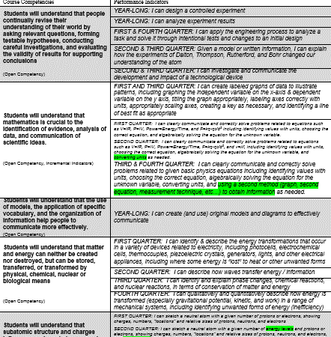
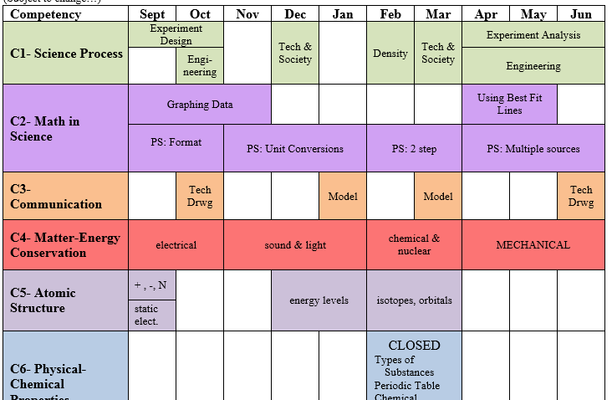
Content Competencies
Full Year Course: ~6-11 Competencies
Connect to Nat’l & State Content Standards
Modelled on Enduring Understandings from UbD
“Open”: All Year
(incremental rubrics)
“Closed”: Unit
Notes:
“Open” competencies are assessed throughout the term. There may be several different assessments used to show a breadth of understanding on the same rubric, or there may be similar assessments, with expectations for each increasing throughout the year.
Competency wording is “Students will understand THAT …” (usually also has indicator statements in the form of “I can…”)
OR “Students will demonstrate the ability to …”

Slide 34
Crosswalk Competencies & Standards
Course Competencies
Nat’l / State Standards
C1
C2
C3
C4
…
A
B
C
D
E
Mastery
Introduce
Partial…
Partial…
Mastery
Mastery
NOT Taught because…
Notes:
Check – do your competencies address all the standards you are supposed to meet in the course? Are there competencies that are not tied to content standards? If so, WHY? Are there standards that you are not addressing? WHY?
Initially, we all “did” this, but informally – we didn’t require “documentation” or evidence that your competencies met all the standards.

Slide 35
Content Competencies
Geometry
Physical Science
System allows “interdisciplinary” competencies – different teachers scoring same competency in different courses.
C1
C1
C9
C3
C8
C2
C3
C2
We do NOT do this for content competencies… (yet…)

Slide 36
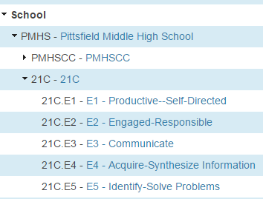
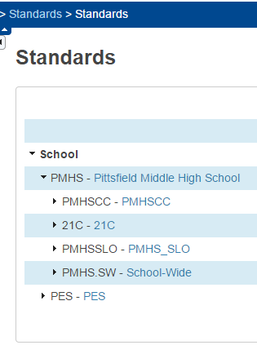
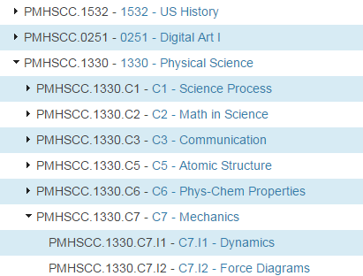
Standards
21st Century
Learning Expectations
Course Competencies
& Indicators
No longer used, but can’t delete…

Slide 37
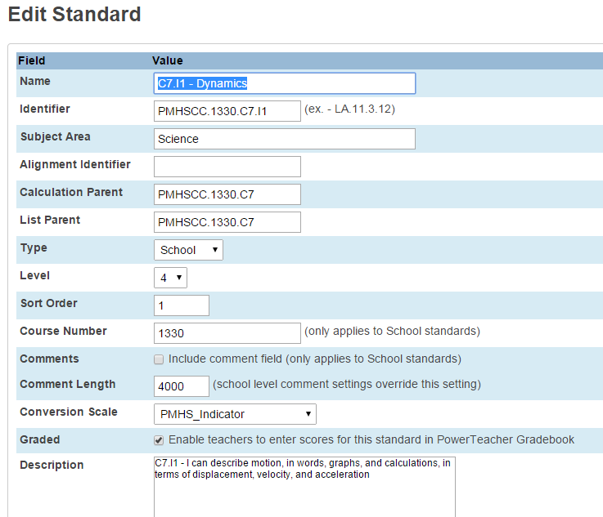
Standards
“Description” is stored in standards table → if you change it, you change it for every student who ever had a grade on that standard.
Year 2: We left description BLANK. Teachers pasted statement of competency into COMMENT → stored in standards grades table, so can be changed next time you teach course…
Notes:
Standards Grades table has foreign key of standards table, so standard & description are the same for every student who every had or will have an assignment linked to that standard.

Slide 38
USE A SPREADSHEET for initial import of competencies!
Individual changes & new competencies are entered by a secretary / data-entry person after approval by Dept.
Notes:
LOT of work to initially enter competencies in the system. Way more work than it should be to enter new competencies.

Slide 39
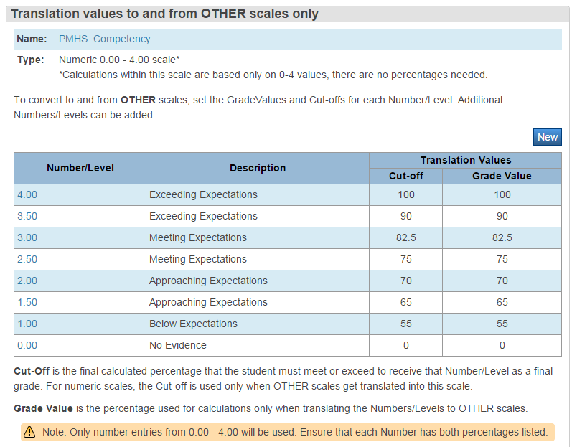
Standards Conversion Scales
Our community OBSESSED over this before we began!!!
CARE with this aides transition-- teachers can enter percentage grade & system auto-calculates competency 0-4 mark.
Notes:
**We could have used a different scale for the overall for example… we could have had the overall grade be reported as EE(exceeding expectations) ME (meeting…) etc… We just chose to leave it all as numbers 0-4 to simplify things.

Slide 40
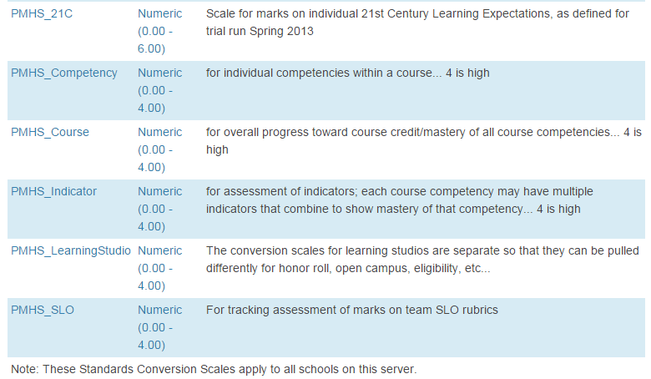
Standards Conversion Scales
We use different “conversion scale” for each type of competency because it’s a convenient way to QUERY. Ie, All students failing two or more competencies in a course, vs all students with a failing overall competency average…
Conversion values in each scale are identical for us.

Slide 41
Content Competency Marks
Marks are numeric: 0 - 4 (“Passing” = 2.5)
4 point rubric for each competency or indicator
Competency (indicator) mark = WEIGHTED AVERAGE of rubric scores
WEIGHTED AVG of competency rubric scores
“Traditional” average of assignment grades

Slide 42
Competency Marks Example: Formative vs Summative
“Weighted Average” still means the system considers how many points the assignment is worth…
•Students tended not to do formative assessments because they weren’t being graded.
“HW” formatives often can not be redone / late
• Some formatives are “ticket” to take summative
• Teacher can easily exempt formatives as appropriate

Slide 43
Competency Marks Example: Incremental / Most Recent
Math Problem Solving Indicator – “OPEN”
Expectations on rubrics increase throughout year –
3 incremental rubrics
When next level assessment is taken, teacher “exempts” previous one….
For this indicator, only single most recent assessment “counts” at any time…
(next year, most recent TWO counted)
“Exempt” –
NOT counting toward weighted avg
Notes:
A single click lets the teacher “exempt” all the marks for that assignment when the next class assessment / benchmark point is reached.
Each student working at own pace? Teacher can exempt prior level assessment for individual student as he/she reaches each new benchmark level.
Midterm Exam assessment ALWAYS counts.

Slide 44
Competency Marks Example: Indicators
Science Process Competency – “Open”
Multiple Indicators – BREADTH --student can be “competent” in science process in many ways:
… Summer Competency Recovery Project – manual override of calculated competency grade…

Slide 45
Competency Marks Example: BREADTH of Assessments

Slide 46
Competency Marks Example: Projects
Motor Project Grade
Motor Project
Written Test
REassess
Energy
Energy
EM
Engineering
Technical Drwg
Vehicle Project
REassess
Energy
Mechanics
The Motor Project is entered as FOUR “assignments”
Engineering
Technical Drwg
TRANSITION – away from a “motor project grade” toward individually assessing competencies that may be demonstrated in that project. Entering as different assignments pushes that paradigm shift.
Notes:
Example: Motor engineering project earns marks in C1 science process (engineering), C9 electromagnetism, C3 communication, & C4 energy.
What if the student does a great job with the communication (technical drawing), electromagnetism & energy content, but does not demonstrate good engineering process skills? Why would the student have to “redo” the motor project? The student can demonstrate competency in engineering during the vehicle project.
***TRANSITION – away from a “motor project grade” toward individually assessing competencies that may be demonstrated in that project. Entering as different assignments pushes that paradigm shift.
You COULD create one assignment for “motor project” and connect that assignment to four standards.

Slide 47
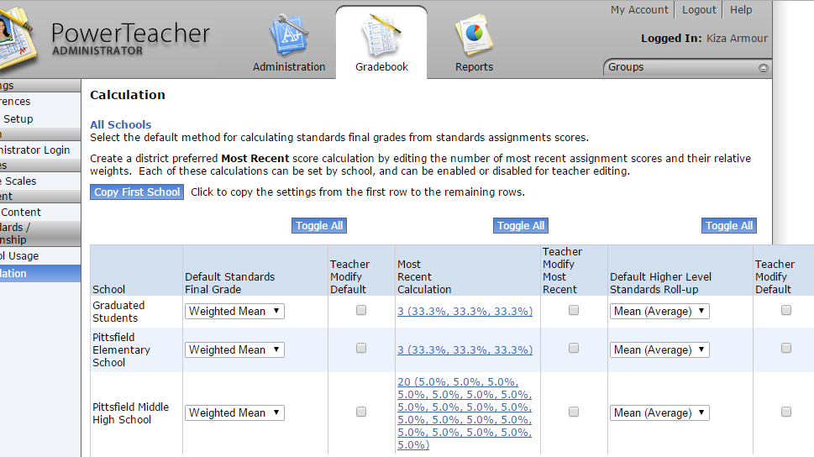
PT Administrator SETUP
Set Calculation of Standards
Notes:
We do NOT allow teachers to change the way standard grades are calculated. We believe that at least some teachers would change the settings and not even realize what effect it has on the calculation of their standards grades.
“Most Recent” can still be accomplished by just “exempting” assessments that should not be included.
The simple mean is used for rolling up lower level standards – we decided that the overall course grade would be a simple average of competency grades… but that whole system was established BEFORE powerschool allowed calculation of term marks based on standards grades. We also intentionally set that competencies would be simple average of their indicator scores, when indicators were used.

Slide 48
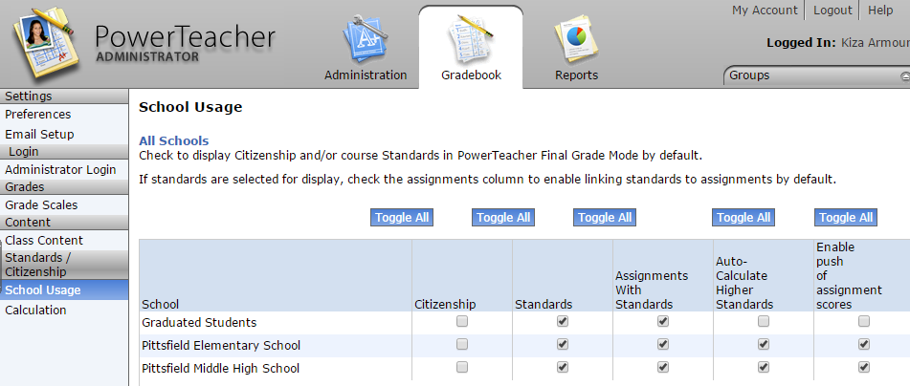
PT Administrator SETUP
Allow Use of Standards
Indicators avg = competency mark;
Competency avg = overall course competency.
Allows teacher to enter % and have standards score auto-calculate.

Slide 49
USE of Content Competency Marks
Final Course Grade
What do you DO with those content competency marks?
Academic Privilege Eligibility
Competency Recovery / Interventions
“At-Risk” is failing two or more competencies in the course…. If you must meet each individual competency, then overall average is not best determination of “at risk”

Slide 50

Competency vs Final Grade
Content Competencies
Overall Course Competency
Traditional Letter Grade
3.1
3.8
3.5
3.6
Student has “NC,” regardless of average, until EVERY content competency is met.
Simple Average
of competencies

Slide 51
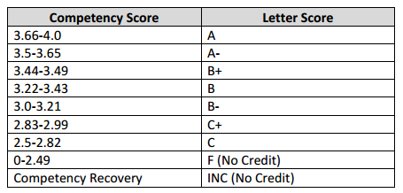
Awarding Credit &
Final LETTER Grade
*Credit is awarded only when EVERY individual course competency is mastered (2.5 or better)
2014-2015
2012-2013
2013-2014
A
A
B
B
C
GPA
INC
INC
F
Teachers manually enter letter grade...
We haven’t settled on a scale…
Notes:
In January of 2015, I have seniors trying to begin competency recovery plans from their 2012-2013 physical science course, because there was no “failure” mark that year. That is why we restored the “F” in 2013-2014 for students who were not eligible for competency recovery, or did not complete by deadline.
2014-2015 seems to be a step backwards – complaints about the small difference in student gpa’s / class rank caused admin to restore + & - grades.

Slide 52
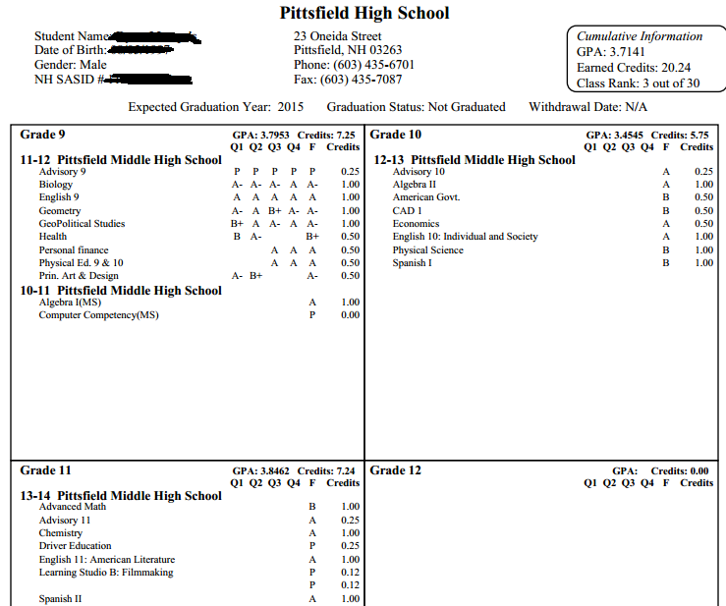
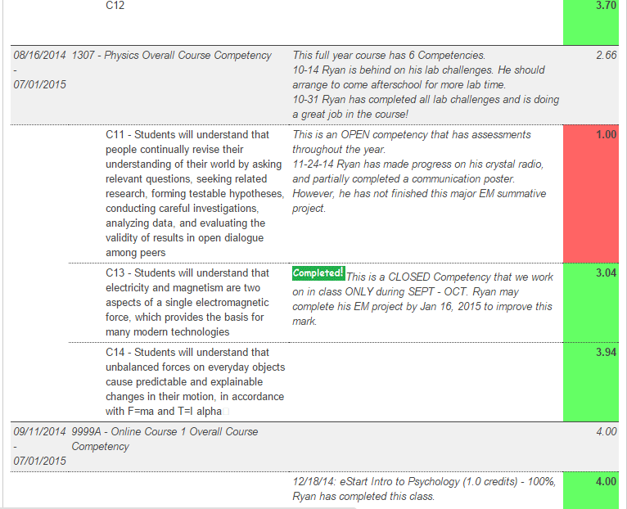
Reporting:
Different Audiences,
Different Purposes,
Different Formats.
Final Letter Grade
Transcripts
Final
Report Card
GPA
Overall Course
Competency
credits
Eligibility
Individual
Course
Competencies
Honor
Roll
Qtr
Progress
Reports
At Risk
Assessments
& Rubrics
Web
Notes:
The further the audience is from the classroom, the more “traditional” the reporting is…

Slide 53
PMHS Quarterly
Progress Reports
Custom “Standards” Tab
From Quick Lookup →
Shows Course Competencies
AND Comments
*Rolling Grades!
LIVE on Web!
Overall & Comments
Print the screen and mail it home each quarter…
Transitioning parents away from need for printed copy…
Competencies & Comments

Slide 54
Communicating Grades…
It’s the 21st Century!!!!
WHY put time & effort into something to be printed on paper by office/admin personnel????
ReportWorks
“Standards-Based Report Card”
Grades on Standards are NOT “STORED” in historical, only calculated “term grades” are stored.

Slide 55
Traditional Transcript
WILL redesign in June/July
This is the last year students have “Quarter” grades on transcript.

Slide 56
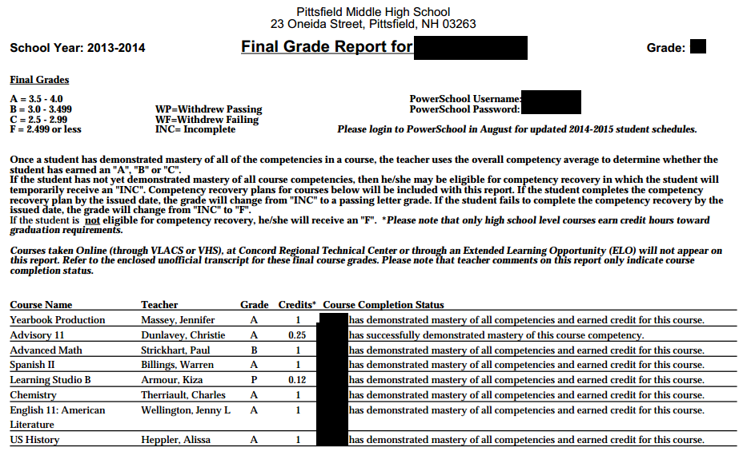
Traditional Year End Report Card
Disappearing Soon??
Standardized teacher term comments just indicate completion, or NOT eligible for comp recovery, or comp recovery plan due date xxxxxx.
Notes:
We may just send home an unofficial transcript at the end of the year, along with the “progress report” standards screen…

Slide 57
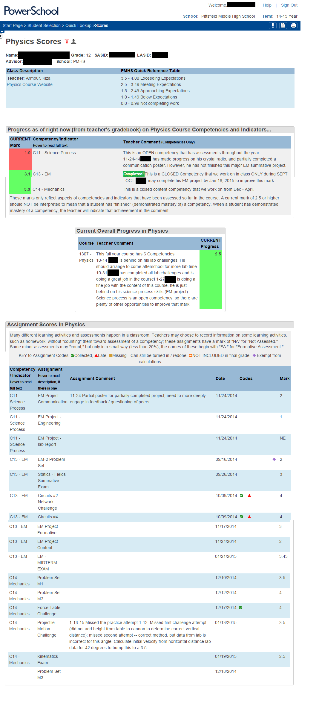
Custom Scores
Detail Page
Course Competency AND Indicator Marks and comments
Overall course competency & comments
Individual assignments
Competency/indicator
Assignment name
Assignment comments
Due Date
Competency Mark
Missing / Late / Exempt / ✓

Slide 58
Individual Assessments…

Slide 59
Overall vs Content Competencies
Overall: Used midcourse to determine NHIAA eligibility (“passing 4 courses…”)
Content: Used to begin competency recovery & to determine “at-risk”
Honor Roll & Academic Eligibility have been transitioning – from overall to individual content competencies

Slide 60
DOE Competency Resources
  Competency Validation Rubric
  DOE site – OLD sample course competencies, newer example competencies by discipline/subject area

