Slide 1


Competency-Based Assessment and Reporting
Pittsfield Middle High School
Pittsfield, NH
School Year 2014-2015

Slide 2
Competency-Based
Currently…
Each course has content competencies with 4 point course-specific rubrics
Students earn credit only after demonstrating mastery of every competency in the course
Every assessment connects to a competency rubric
Avg competency marks → Transcript Letter Grade
Intended…
Five School-Wide 21st Century Learning Expectations
Single 6 point rubric for each 21st Cent. LE used by all teachers, courses, grades, providing FORMATIVE assessment
Annual summative assessment of 21st Cent LE for each student happens at Exhibition in June
21st Cent LE are NOT calculated into course marks

Slide 3
Different Types of Competencies
Course Content Competencies
EM
PE
Art I
Energy
Mechanics
Physical
Science
Math in Science
Spanish II
21st Century Learning Expectations
Science Process
Geometry
Advisory
SLO
English 10
Economics
Learning
Studio

Slide 4
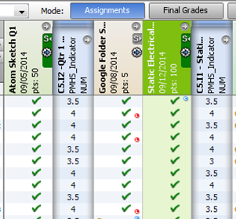
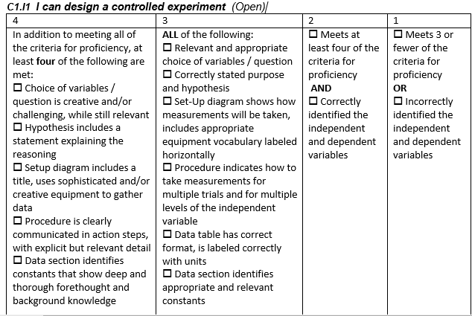
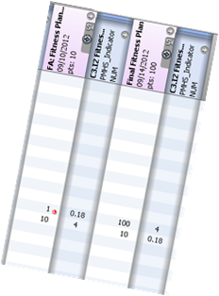
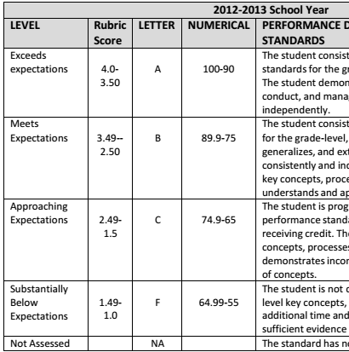
Paradigm Shift…
% → Competency
2014-2015
Marks on competency rubrics, not assignment percentages
How am I doing on EACH competency…
On this assessment, I earned xx on the competency rubric
2013-2014
My overall competency average is xx right now, so I’m “passing” the course…
2012-2013
Rolling Grades
I earned xx%…
What competency grade is that?
2011-2012
More consultants and team vetting… Spring Semester “pilot” by some teachers… how does this work in the classroom?
2010-2011
Consultants, visits to other schools, teacher team work to develop and vet competencies
Notes:
For us, the big shift was from the idea of overall percentage grades on assignments being averaged together to make a course grade, to the idea of rubric grades on competencies.

Slide 5
Wording has Changed…
Numbers Remain
4
3
2
1
Proficient with Distinction
Proficient
Partially Proficient
Substantially Below Proficient
Exceeding Expectations
Meeting Expectations
Approaching Expectations
Not Yet Meeting Expectations / Below Expectations
2.5 = “Demonstrating Mastery” or “Passing”
0 = NE = “No Evidence”

Slide 6
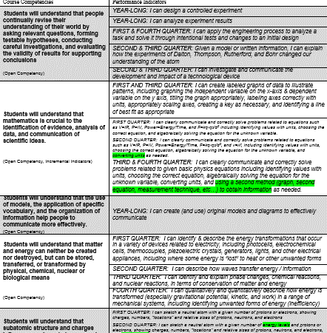
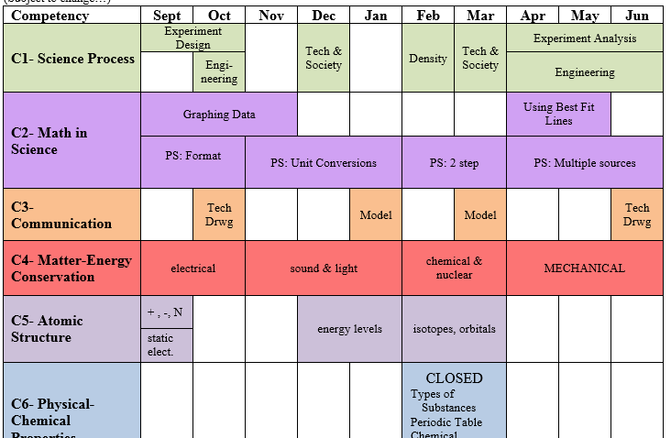
Content Competencies
Full Year Course: ~6-11 Competencies
Connect to Nat’l & State Content Standards
Modelled on Enduring Understandings from UbD
“Open”: All Year
(incremental rubrics)
“Closed”: Unit
Notes:
“Open” competencies are assessed throughout the term. There may be several different assessments used to show a breadth of understanding on the same rubric, or there may be similar assessments, with expectations for each increasing throughout the year.
Competency wording is “Students will understand THAT …” (usually also has indicator statements in the form of “I can…”)
OR “Students will demonstrate the ability to …”

Slide 7
Many Course Competencies also have “Indicators”…
Physical Science Competencies have Indicators
Engineering
C1 Science Process
Indicators suggest breadth of skills, without requiring mastery of each
Experiment Design
Use of Equipment
AVERAGE of Indicator marks = Competency mark
Describing Motion
C7 Mechanics
Force Diagrams
Newton’s Laws
Many teachers are moving AWAY from using “indicators.”

Slide 8
Content Competencies
Geometry
Physical Science
System allows “interdisciplinary” competencies – different teachers scoring same competency in different courses.
C1
C1
C9
C3
C8
C2
C3
C2
We do NOT do this for content competencies… (yet…)

Slide 9
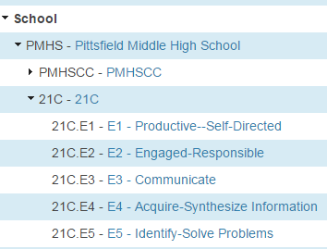
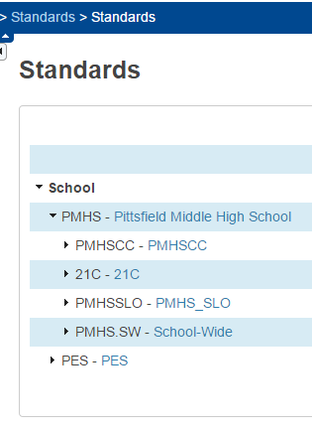
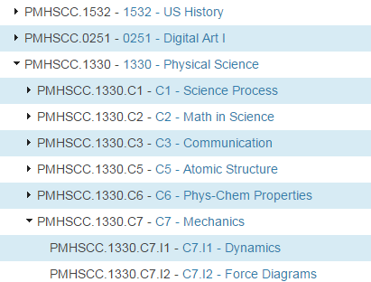
Standards
21st Century
Learning Expectations
Course Competencies
& Indicators
No longer used, but can’t delete…

Slide 10
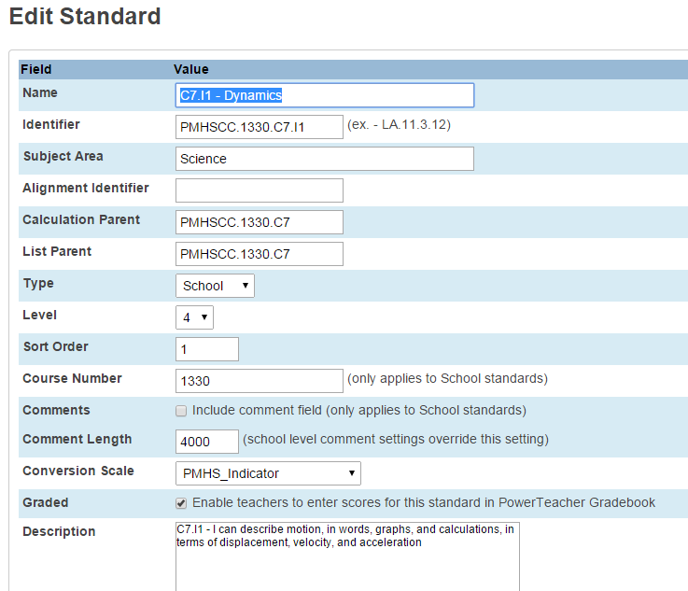
Standards
“Description” is stored in standards table → if you change it, you change it for every student who ever had a grade on that standard.
Year 2: We left description BLANK. Teachers pasted statement of competency into COMMENT → stored in standards grades table, so can be changed next time you teach course…

Slide 11
USE A SPREADSHEET for initial import of competencies!
Individual changes & new competencies are entered by a secretary / data-entry person after approval by Dept.

Slide 12
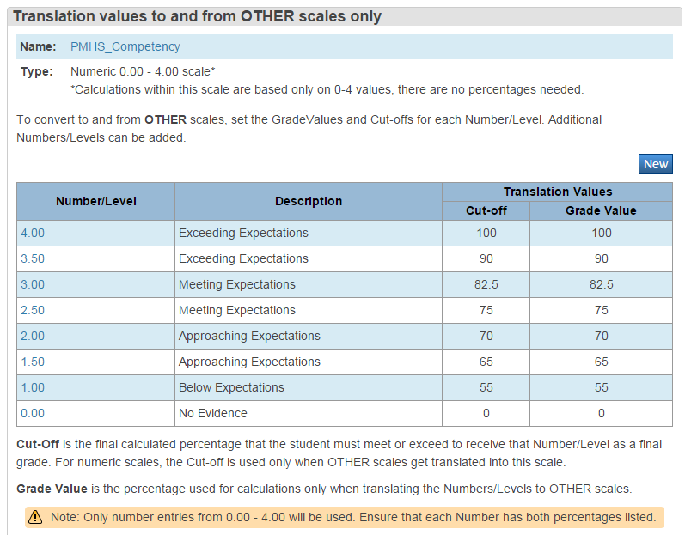
Standards Conversion Scales
Our community OBSESSED over this before we began!!!
CARE with this aides transition - teachers can enter percentage grade & system auto-calculates competency 0-4 mark.

Slide 13
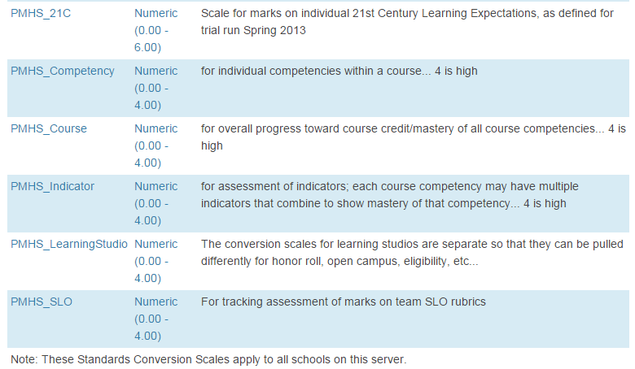
Standards Conversion Scales
We use different “conversion scale” for each type of competency because it’s a convenient way to QUERY. Ie, All students failing two or more competencies in a course, vs all students with a failing overall competency average…
Conversion values in each scale are identical

Slide 14
Content Competency Marks
Marks are numeric: 0 - 4 (“Passing” = 2.5)
4 point rubric for each competency or indicator
Competency (indicator) mark = WEIGHTED AVERAGE of rubric scores
WEIGHTED AVG of competency rubric scores
“Traditional” average of assignment grades

Slide 15
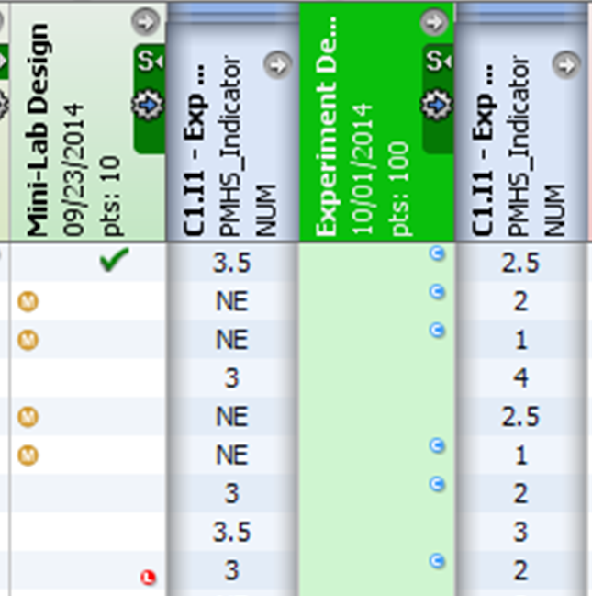
Competency Marks Example: Formative vs Summative
“Weighted Average” still means the system considers how many points the assignment is worth…
Students tended not to do formative assessments because they weren’t being graded.
Those “HW” formatives often can not be redone / competed late.
Some formative assessment is “ticket” to be able to take the summative

Slide 16
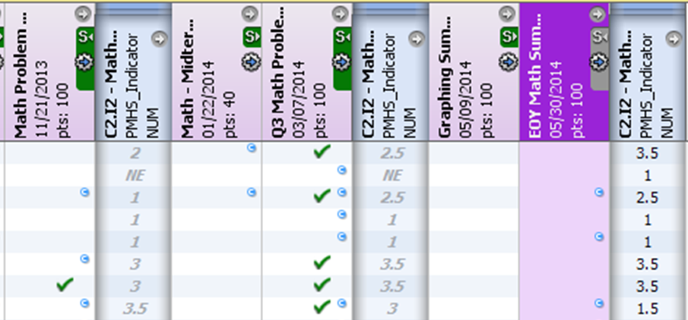
Competency Marks Example: Incremental / Most Recent
Math Problem Solving Indicator – “OPEN”
Expectations on rubrics increase throughout year –
3 incremental rubrics
When next level assessment is taken, teacher “exempts” previous one….
For this indicator, only single most recent assessment “counts” at any time…
(next year, most recent TWO counted)
“Exempt” –
NOT counting toward weighted avg
Notes:
A single click lets the teacher “exempt” all the marks for that assignment when the next class assessment / benchmark point is reached.
Each student working at own pace? Teacher can exempt prior level assessment for individual student as he/she reaches each new benchmark level.
Midterm Exam assessment ALWAYS counts.

Slide 17
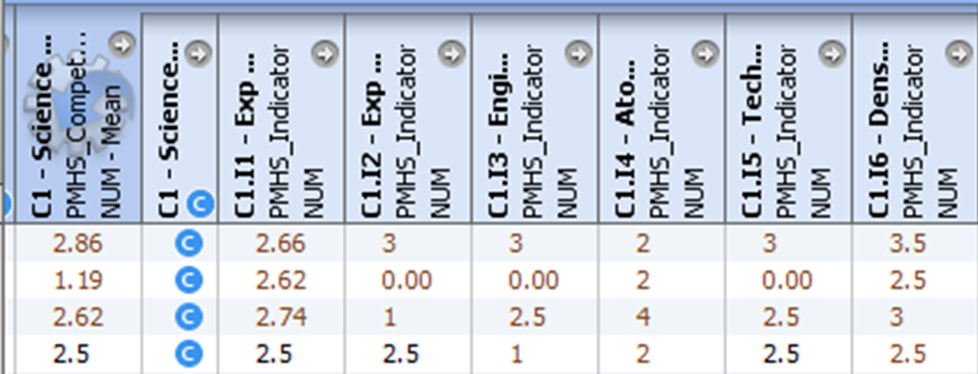
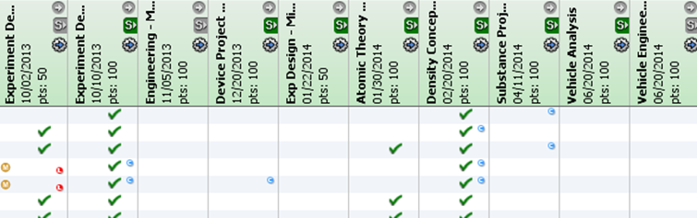
Competency Marks Example: Indicators
Science Process Competency – “Open”
Multiple Indicators – BREADTH --student can be “competent” in science process in many ways:
… Summer Competency Recovery Project – manual override of calculated competency grade…

Slide 18
Competency Marks Example: BREADTH of Assessments

Slide 19



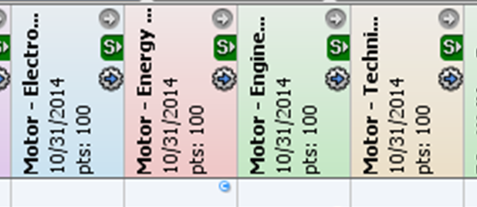
Competency Marks Example: Projects
Motor Project Grade
Motor Project
Written Test
REassess
Energy
Energy
EM
Engineering
Technical Drwg
Vehicle Project
REassess
Energy
Mechanics
The Motor Project is entered as FOUR “assignments”
Engineering
Technical Drwg
TRANSITION – away from a “motor project grade” toward individually assessing competencies that may be demonstrated in that project. Entering as different assignments pushes that paradigm shift.
Notes:
Example: Motor engineering project earns marks in C1 science process (engineering), C9 electromagnetism, C3 communication, & C4 energy.
What if the student does a great job with the communication (technical drawing), electromagnetism & energy content, but does not demonstrate good engineering process skills? Why would the student have to “redo” the motor project? The student can demonstrate competency in engineering during the vehicle project.
***TRANSITION – away from a “motor project grade” toward individually assessing competencies that may be demonstrated in that project. Entering as different assignments pushes that paradigm shift.
You COULD create one assignment for “motor project” and connect that assignment to four standards.

Slide 20
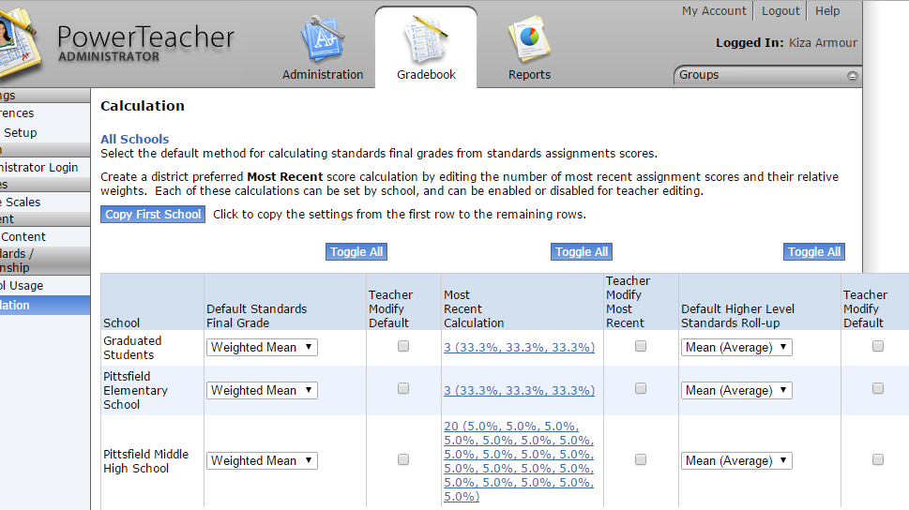
PT Administrator SETUP
Set Calculation of Standards
Notes:
We do NOT allow teachers to change the way standard grades are calculated. We believe that at least some teachers would change the settings and not even realize what effect it has on the calculation of their standards grades.
“Most Recent” can still be accomplished by just “exempting” assessments that should not be included.
The simple mean is used for rolling up lower level standards – we decided that the overall course grade would be a simple average of competency grades… but that whole system was established BEFORE powerschool allowed calculation of term marks based on standards grades. We also intentionally set that competencies would be simple average of their indicator scores, when indicators were used.

Slide 21
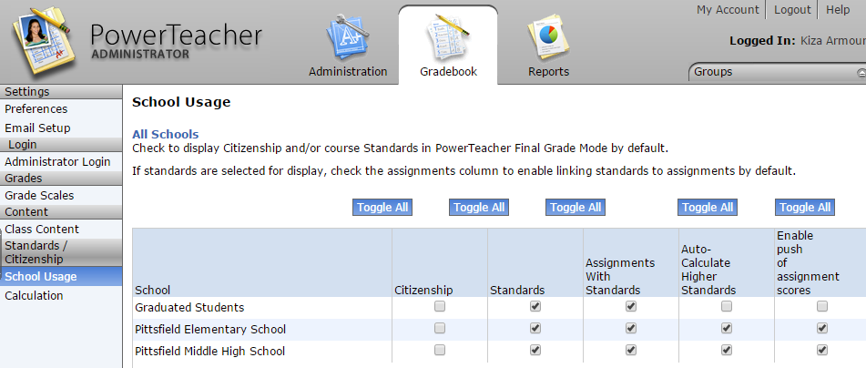
PT Administrator SETUP
Allow Use of Standards
Indicators avg = competency mark;
Competency avg = overall course competency.
Allows teacher to enter % and have standards score auto-calculate.

Slide 22
USE of Content Competency Marks
Final Course Grade
What do you DO with those content competency marks?
Academic Privilege Eligibility
Competency Recovery / Interventions
“At-Risk” is failing two or more competencies in the course…. If you must meet each individual competency, then overall average is not best determination of “at risk”

Slide 23

Competency vs Final Grade
Content Competencies
Overall Course Competency
Traditional Letter Grade
3.1
3.8
3.5
3.6
Student has “NC,” regardless of average, until EVERY content competency is met.
Simple Average
of competencies

Slide 24
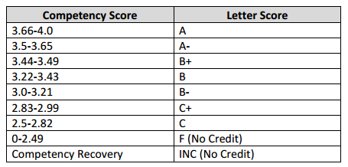
Awarding Credit &
Final LETTER Grade
*Credit is awarded only when EVERY individual course competency is mastered (2.5 or better)
2014-2015
2012-2013
2013-2014
A
A
B
B
C
GPA
INC
INC
F
Teachers manually enter letter grade...
We haven’t settled on a scale…
Notes:
In January of 2015, I have seniors trying to begin competency recovery plans from their 2012-2013 physical science course, because there was no “failure” mark that year. That is why we restored the “F” in 2013-2014 for students who were not eligible for competency recovery, or did not complete by deadline.
2014-2015 seems to be a step backwards – complaints about the small difference in student gpa’s / class rank caused admin to restore + & - grades.

Slide 25
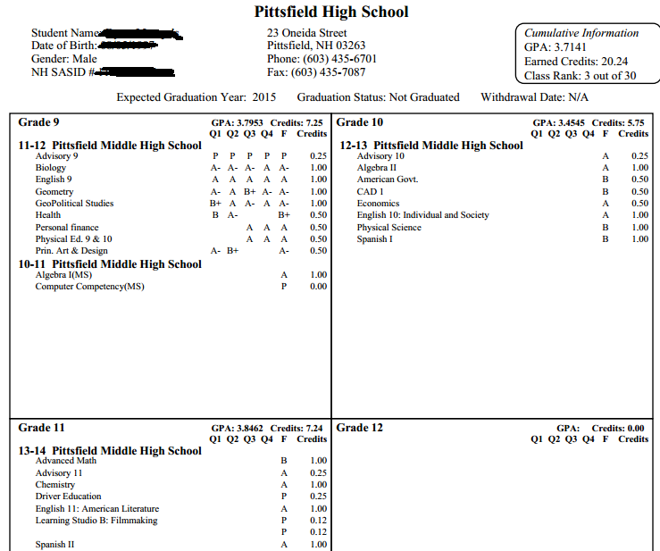
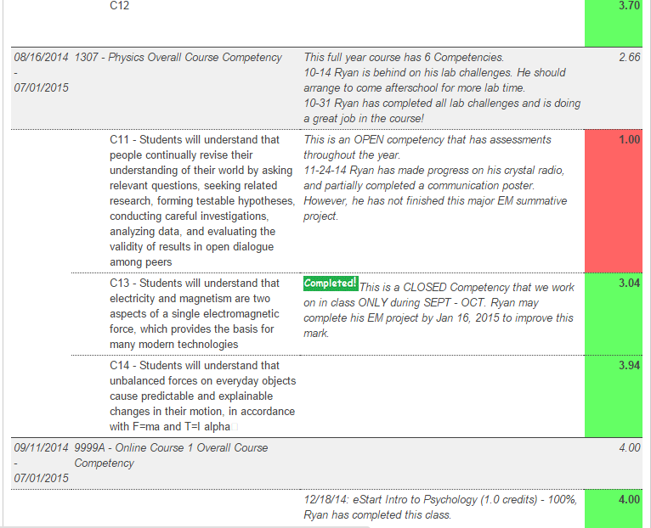
Reporting:
Different Audiences,
Different Purposes,
Different Formats.
Final Letter Grade
Transcripts
Final
Report Card
GPA
Overall Course
Competency
credits
Eligibility
Individual
Course
Competencies
Honor
Roll
Qtr
Progress
Reports
At Risk
Assessments
& Rubrics
Web

Slide 26
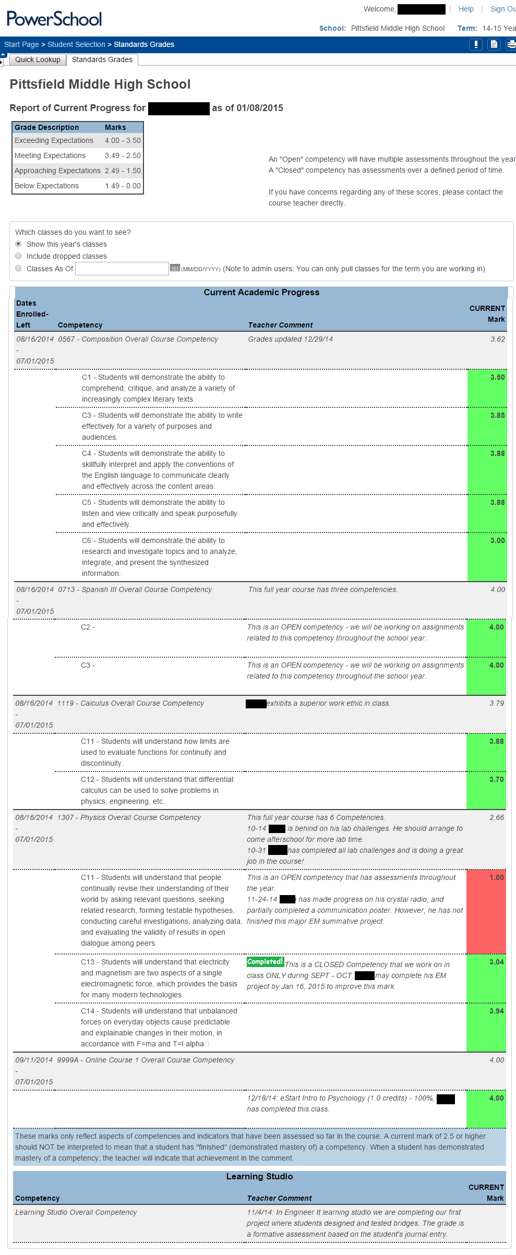
PMHS Quarterly
Progress Reports
Custom “Standards” Tab
From Quick Lookup →
Shows Course Competencies
AND Comments
*Rolling Grades!
LIVE on Web!
Overall & Comments
Print the screen and mail it home each quarter…
Transitioning parents away from need for printed copy…
Competencies & Comments

Slide 27
Communicating Grades…
It’s the 21st Century!!!!
WHY put time & effort into something to be printed on paper by office/admin personnel????
ReportWorks
“Standards-Based Report Card”
Grades on Standards are NOT “STORED” in historical, only calculated “term grades” are stored.

Slide 28
Traditional Transcript
WILL redesign in June/July
This is the last year students have “Quarter” grades on transcript.

Slide 29
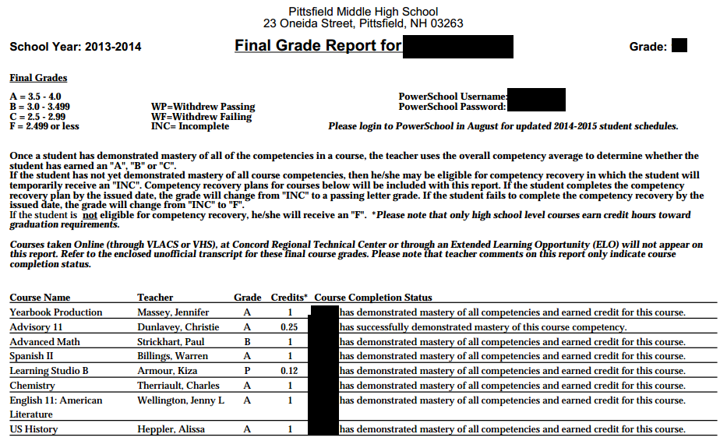
Traditional Year End Report Card
Disappearing Soon??
Standardized teacher term comments just indicate completion, or NOT eligible for comp recovery, or comp recovery plan due date xxxxxx.

Slide 30
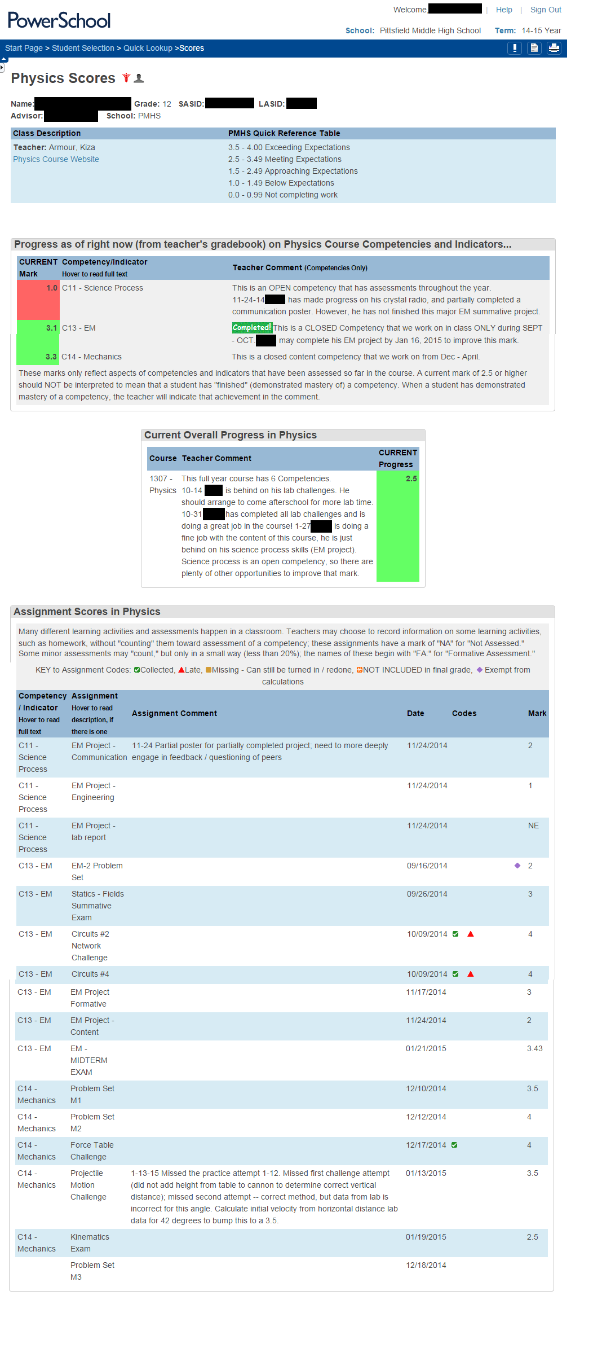
Custom Scores
Detail Page
Course Competency AND Indicator Marks and comments
Overall course competency & comments
Individual assignments
Competency/indicator
Assignment name
Assignment comments
Due Date
Competency Mark
Missing / Late / Exempt / ✓

Slide 31
Individual Assessments…

Slide 32
Overall vs Content Competencies
Overall: Used midcourse to determine NHIAA eligibility (“passing 4 courses…”)
Content: Used to begin competency recovery & to determine “at-risk”
Honor Roll & Academic Eligibility have been transitioning – from overall to individual content competencies

